Slide 1
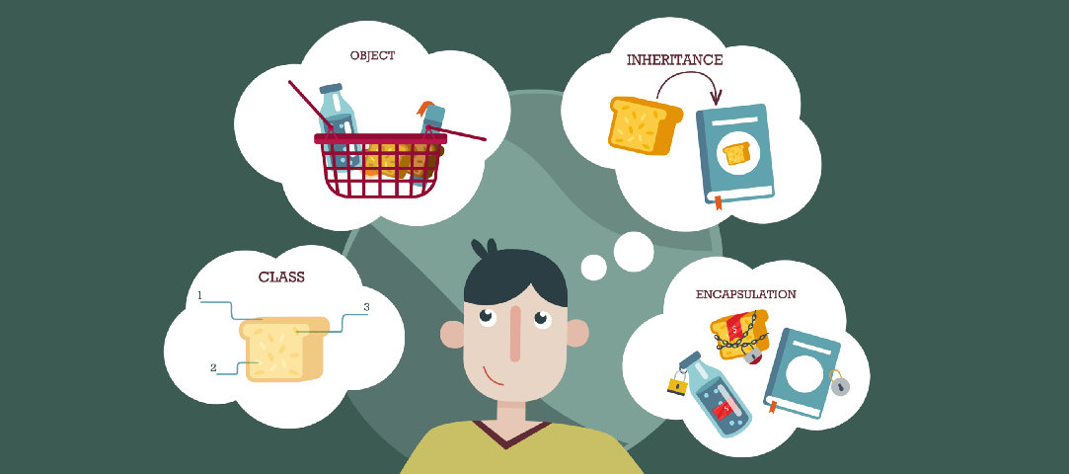
Lecture – 3.1 JAVA: Introduction, Keywords, Data Types, Identifiers
Afsara Tasneem Misha
Lecturer
Department of CSE
Daffodil International University

Slide 2
Contents
Introduction to Java
Keywords in Java
Data Types in Java
Java Identifiers

Slide 3
Introduction to Java

Slide 4
Introduction to Java
Java is a high-level programming language originally developed by Sun Microsystems and released in 1995.
Java runs on a variety of platforms, such as Windows, Mac OS, and the various versions of UNIX.

Slide 5
Features of Java
Object Oriented: In Java, everything is an Object. Java can be easily extended since it is based on the Object model.
Platform independent: Unlike many other programming languages including C and C++, when Java is compiled, it is not compiled into platform specific machine, rather into platform independent byte code. This byte code is distributed over the web and interpreted by virtual Machine (JVM) on whichever platform it is being run.
Simple: Java is designed to be easy to learn. If you understand the basic concept of OOP Java would be easy to master.
Secure: With Java's secure feature it enables to develop virus-free, tamper-free systems. Authentication techniques are based on public-key encryption.
Architectural-neutral: Java compiler generates an architecture-neutral object file format which makes the compiled code to be executable on many processors, with the presence of Java runtime system.
Portable: Being architectural-neutral and having no implementation dependent aspects of the specification makes Java portable. Compiler in Java is written in ANSI C with a clean portability boundary which is a POSIX subset.

Slide 6
Features of Java
Robust: Java makes an effort to eliminate error prone situations by emphasizing mainly on compile time error checking and runtime checking.
Multithreaded: With Java's multithreaded feature it is possible to write programs that can do many tasks simultaneously. This design feature allows developers to construct smoothly running interactive applications.
Interpreted: Java byte code is translated on the fly to native machine instructions and is not stored anywhere. The development process is more rapid and analytical since the linking is an incremental and light weight process.
High Performance: With the use of Just-In-Time compilers, Java enables high performance.
Distributed: Java is designed for the distributed environment of the internet.
Dynamic: Java is considered to be more dynamic than C or C++ since it is designed to adapt to an evolving environment. Java programs can carry extensive amount of run-time information that can be used to verify and resolve accesses to objects on run-time.

Slide 7
Tools you will need
For performing the examples discussed in this tutorial, you will need a Pentium 200-MHz computer with a minimum of 64 MB of RAM (128 MB of RAM recommended)
You also will need the following software:
Operating system.
JDK (Java Development Kit)
Java editor

Slide 8
Popular Java Editors
To write your Java programs, you will need a text editor. There are even more sophisticated IDEs available in the market. But for now, you can consider one of the following:
Notepad: On Windows machine you can use any simple text editor like Notepad, TextPad.
Netbeans: is a Java IDE that is open-source and free which can be downloaded from http://www.netbeans.org/index.html
Eclipse: is also a Java IDE developed by the eclipse open-source community and can be downloaded from http://www.eclipse.org/

Slide 9
Simple Java Program
public class MyFirstJavaProgram {
public static void main(String []args) {
System.out.println("Hello World");
}
}

Slide 10
Keywords in java

Slide 11
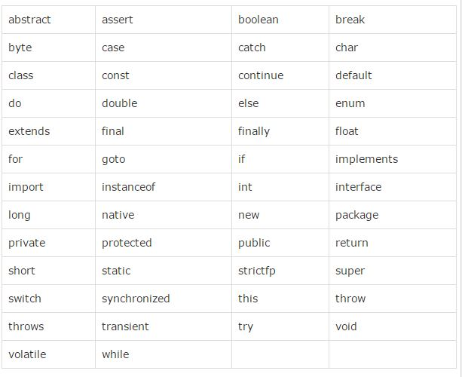
Java Keywords

Slide 12
Data Types in java

Slide 13
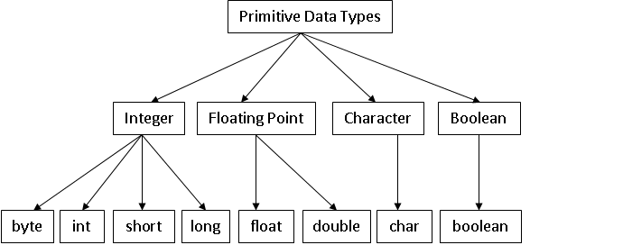
Data Types

Slide 14
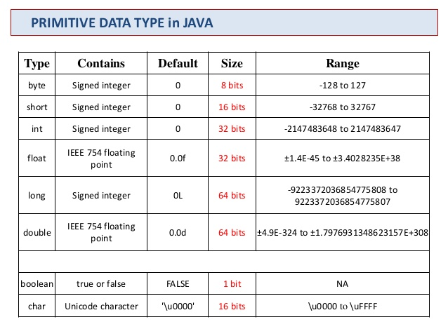

Slide 15
Exercise
What are the differences between the constants 7, ‘7’ and “7”?

Slide 16
Identifiers in java

Slide 17
Java Identifiers
Names used for classes, variables and methods are called identifiers.
All identifiers must follow the following rules:
An identifier is a sequence of characters that consists of letter (A to Z or a to z), digits(0 to 9), currency character ($) or an underscore (_).
All identifiers should begin with a letter (A to Z or a to z), currency character ($) or an underscore (_).It can not start with a digit (0-9).
A keyword cannot be used as an identifier.
Most importantly identifiers are case sensitive.
area, Area, AREA are all different identifiers
Examples of legal identifiers: age, $salary, _value, __1_value
Examples of illegal identifiers: 123abc, -salary

Slide 18
Exercise
Find out the legal Identifiers
$2 2A area d+4 Max-Number
Min_number aaa sales_tax _circleArea a2b
Box100width /$directory ab1234$$ ComputeArea

Slide 19

Thank you!

